Slide 1
Avoiding OCL specification pitfalls
Understanding Software Modeling by Using Constraints
Dan CHIOREAN

Slide 2
Understanding Software Modeling by Using Constraints Motivation
MDE technologies requires a clear and complete model specification
Design by Contracts supports producing rigorous models
Using this technique is not so widespread as expected
this state of facts was caused by different rationales
people are not yet convinced about the advantages that can be obtained
=> they should be motivated about using constraints
this shape their mentality

Slide 3
Understanding Software Modeling by Using Constraints
To prove:
the necessity of employing constraints, by means of relevant examples
To presents:
best principles & valid practices for specifying constraints
Our approach is focused on the:
role of complete and unequivocal requirements,
importance of the rigor in specifying constraints,
specification process that supports the return in earlier phases, including requirements
And highlights on the:
conformance between requirements & specifications,
importance of choosing a design model from different proposals,
need of testing specifications by using snapshot

Slide 4
Understanding Software Modeling by Using Constraints OCL specifications – state of facts
many books, articles and slides about OCL: Warmer, Gogolla, Hussmann, Demuth, Atkinson, etc
many OCL examples (including the UML static semantics specification) are hasty,
avoiding hasty specification through some best practice & principles
Aspects related to OCL specs:
usefulness of information when constraints are broken
intelligibility and suggestiveness of specification
use of constraint specification patterns
conformity between evaluation of constraints specified in:
OCL and
programming languages (generated from specs)
independence of the results obtained from the OCL tools used

Slide 5
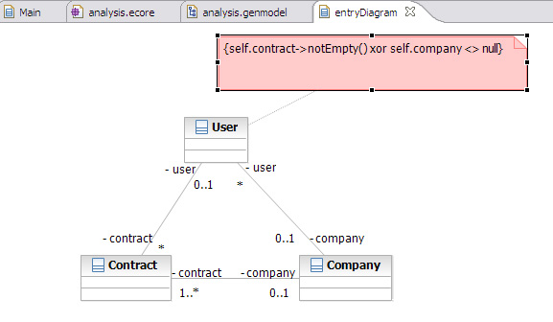
Testing Software Modeling by Using Constraints Understanding the problem and the problem domain
“… the library offers a subscription to each person employed in an associated company. In this case, the employee does not have a contract with the library but with the society he works for, instead.”
https://www.ibm.com/developerworks/rational/library/accurate-domain-models-using-ocl-constraints-rational-software-architect/
Notes:
The first information missing about this model is that concerning its probable usage. In our opinion, this concerns the information system of a library, that stores
information about library users, associated companies, books, book copies and loans. The library may have many users and different associated companies. Also, the relationships between different concepts are missing or vague described – how many contracts may have a user, why? What’s the upper limit of participants at a contract? The natural role names of the association between the user and the company are employer & employee a.s.o.

Slide 6
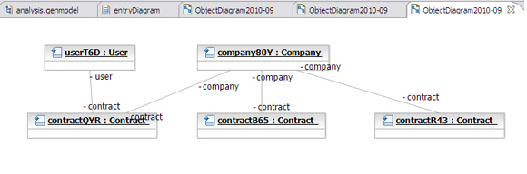
Understanding Software Modeling by Using Constraints Understanding and improving the requirements
snapshots must clarify requirements and the model, but … "one swallow does not make spring"
context User
inv TodConstraint:
self.contract->notEmpty() xor self.company <> null
This model must does not conform to the informally described requirements, even before attaching constraints.
Notes:
In the snapshot presented in this slide, the contractQVR between userT6D and company80Y contradicts the informal requirements because the userT6D is not employed by the company80Y. As the library was not modeled, the contractual relationships with the library cannot be specified in a natural manner.

Slide 7
Understanding Software Modeling by Using Constraints Understanding and improving the requirements_2
The constraints specification process must ask for additional information, meant to support an improved description of requirements, a deeper understanding of the problem, and by consequence, a clear model specification.
The definition of a contract, as taken from http://www.investorwords.com/:
"A binding agreement between two or more parties for performing, or refraining from performing, some specified act(s) in exchange for lawful consideration. “
in our case, the parts in the contract are:
the user on the one hand,
and the library or the company, on the other hand.
Notes:
In the snapshot presented in this slide, the contractQVR between userT6D and company80Y contradicts the informal requirements because the userT6D is not employed by the company80Y. As the library was not modeled, the contractual relationships with the library cannot be specified in a natural manner.

Slide 8
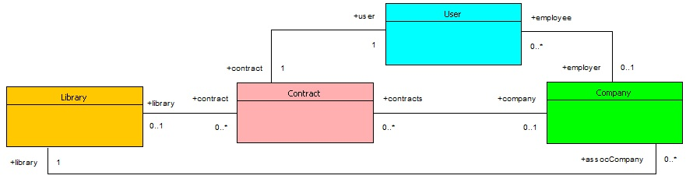
Understanding Software Modeling by Using Constraints Understanding and improving the requirements_3
Improving the solution proposed by choosing an appropriate context & updating constraints,
context User
inv contracts:
if self.contract.library->notEmpty
then self.employer->isEmpty and
self.contract.company->isEmpty
else self.employer = self.contract.company and
self.employer.library->notEmpty
endif
Notes:
Apart from the model proposed in [Tod11], the model included in this slide, includes the library concept. Also, the role name and the multiplicity of roles were changed in order to comply with the requirements and with the understanding of the problem domain. Concerning the invariant restricting the contract participants this was specified in the Contract context and not in the User context like in [Tod11]. The constraint requiring that the contract of a user employed by a company is between the above-mentioned user and company was specified in the User context.

Slide 9
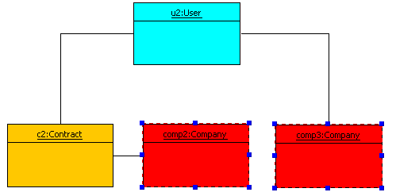
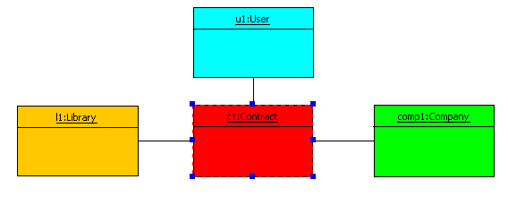
Understanding Software Modeling by Using Constraints Using suggestive snapshots to test specifications
Unwanted model instantiations that are not cached by the invariant proposed in [4]
context User
inv contracts:
if self.contract.library->notEmpty
then self.employer->isEmpty and
self.contract.company->isEmpty
else self.employer = self.contract.company and
self.employer.library->notEmpty
endif
Notes:
The snapshots represented in this side present two unwanted instantiation. The snapshot from the left part shows an instantiation that is not reported by the invariant proposed in the same paper because the library concept was not included in the model. The snapshot from the right part presents a situation in which the user u2 employed by the company comp3 has the contract c2 with the company comp2 and not with comp3.

Slide 10
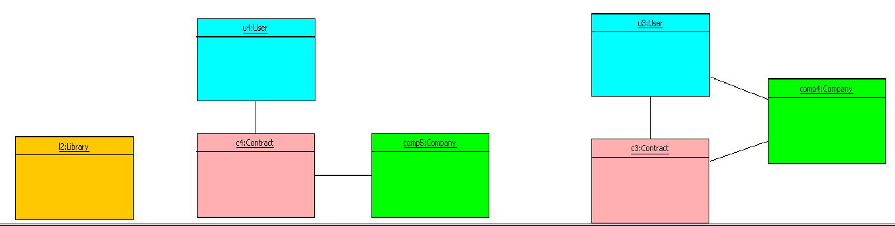
Understanding Software Modeling by Using Constraints Using suggestive snapshots to test specifications
Unwanted model instantiations
context User
inv contracts:
if self.contract.library->notEmpty
then self.employer->isEmpty and
self.contract.company->isEmpty
else self.employer = self.contract.company and
self.employer.library->notEmpty
endif
Notes:
The snapshots represented in this side present two unwanted instantiation. The snapshot from the left part shows an instantiation that is not reported by the invariant proposed in the same paper because the library concept was not included in the model. The snapshot from the right part presents a situation in which the user u2 employed by the company comp3 has the contract c2 with the company comp2 and not with comp3.

Slide 11
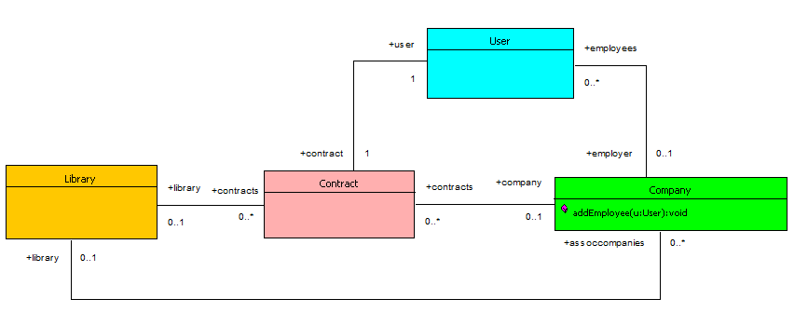
Understanding Software Modeling by Using Constraints It’s better to prevent than cure
context Company::addEmployee(u:User):void
pre:
self.employees->excludes(u)
post:
self.employees@pre->including(u) = self.employees and
u.contract.company = self and
self.contracts.library->includes(u.contract.library@pre)
Notes:
Apart from the model proposed in [Tod11], the model included in this slide, includes the library concept. Also, the role name and the multiplicity of roles were changed in order to comply with the requirements and with the understanding of the problem domain. Concerning the invariant restricting the contract participants this was specified in the Contract context and not in the User context like in [Tod11]. The constraint requiring that the contract of a user employed by a company is between the above-mentioned user and company was specified in the User context.

Slide 12
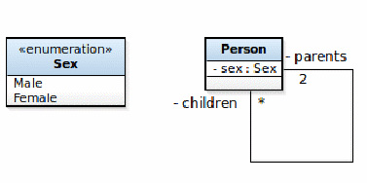
Understanding Software Modeling by Using Constraints Understanding model semantics
in MDD technologies models are used to produce software
self.parents->asSequence()->at(1).sex <>
self.parents->asSequence()->at(2).sex
context Person
inv parentsSex:
self.parents->size = 2 implies
self.parents->first.sex = Sex::female and
self.parents->last.sex = Sex::male
Notes:
Models proposed in MDD technologies are meant to produce software. That’s why the model proposed [Tod11] is inappropriate because induce an infinite recursion. Moreover, the OCL specification has some drawbacks: accessing the elements of the collection will trigger an exception if at least one parent is unknown. Another aspect concerns the comparison of an undefined value with a defined value, that returns different results in different tools (OCLE & USE). Parents collection can be ordered; the first parent playing the role of mother and the second the father. However, this specification cannot be applied if only one parent is known.

Slide 13
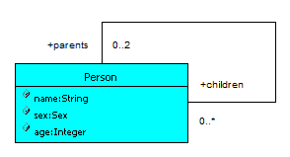
Understanding Software Modeling by Using Constraints Understanding model semantics_2
context Person
inv notSelfParent:
self.parents->select(p | p = self)->isEmpty
context Person
inv parentsAge:
self.parents->reject(p|p.age - self.age >= 16)->isEmpty
context Person::addChildren(p:Person)
pre childrenAge:
self.children->excludes(p) and self.age - p.age >= 16
post chidrenAge:
self.children->includes(p)
Notes:
Forbidding a person to be its own parent can be specified in in different manners. The second invariant, imposing a constraint on the values of the age property of parent and children is finer.

Slide 14
Understanding Software Modeling by Using Constraints Possible pitfalls hidden in OCL specifications
context Person
def allAncestors():Sequence(Person) =
self.parents->union(self.parents.allAncestors())
context Person
def allAncestors():Sequence(Person) =
(Sequence{self}->closure(p | p.parents))->asSequence

Slide 15
Understanding Software Modeling by Using Constraints Possible pitfalls hidden in OCL specifications
The above specifications, although apparently correct, encloses a few pitfalls:
If one of the parents is left unspecified, the model will comply with the WFRs, but the constraint evaluation will end up in an exception when trying to access the missing parent (due to the at(2) call).
In case there are valid references to both parents, but the sex of one of them is not specified, the value of the corresponding subexpression is undefined and the whole expression reduces to either Sex::Male <> undefined or Sex::Female <> undefined. This later expressions provide tool-dependent evaluation results (true in case of USE [1] or Dresden OCL [2] and undefined in case of OCLE [3]).

Slide 16
Understanding Software Modeling by Using Constraints Possible pitfalls hidden in OCL specifications
The above specifications, although apparently correct, encloses a few pitfalls:
In case one of the parents’ sex is undefined, the code generated for the above constraint will provide evaluation results which depend on the position of the undefined value with respect to the comparison operator. According to the tests we have performed, the Java code generated by OCLE and Dresden OCL throws a NullPointerException when the undefined value is located at the left of the <> operator, while evaluating to true in case the undefined value is at the right of the operator and the reference at the left is a valid one. As we are in the context of the MDE paradigm, which relies extensively on automatic code generation, the results provided by the execution of the code corresponding to constraints is an aspect that must be considered when judging the quality of the formal constraints in question.
The OCL expression would have been simpler (not needing an asSequence() call), in case an ordering relation on parents had been imposed at the model level.

Slide 17
Understanding Software Modeling by Using Constraints Possible pitfalls hidden in OCL specifications
When any of the parents’ sex is undefined, the invariant below evaluates to false in Dresden OCL and to undefined in OCLE. In similar circumstances, both Java code snippets generated for this invariant by the two tools return false when executed. Therefore, this invariant shape overcomes the drawbacks of the one from [4] previously pointed at items 1, 3 and 4. The triggering of a NullPointerException by the generated code in case of absence of one of the parents’ sex has been avoided by placing the defined values (the Sex::Female and Sex::Male literals) on the left-hand side of equalities.

Slide 18
Understanding Software Modeling by Using Constraints Possible pitfalls hidden in OCL specifications
The solution to the problem mentioned at item 2 above comes from obeying to the separation of concerns principle. In order to avoid comparisons involving undefined values, whose results may vary with the OCL-supporting tool used, the equality tests of the parents’ sex with the corresponding enumeration literals should be conditioned by both of them being specified. Such a solution is illustrated by means of the invariant proposal below.

Slide 19
Understanding Software Modeling by Using Constraints Possible pitfalls hidden in OCL specifications
The lack of OCL specifications prohibiting undesired model instances (such as parents having the same sex, self-parentship or the lack of a minimum age difference among parents and children) seriously compromises model’s integrity. The first prerequisite for models to reach their purpose is to have a complete and correct specification of requirements, and to deeply understand them.
An incomplete specification reveals its limits when trying to answer questions on various situations that may arise.
Specifying and evaluating OCL constraints should enable us to identify and eliminate bugs, by correcting the requirements and the OCL specifications themselves. Moreover, in the context of MDE, care should be taken to the shape of constraint specifications, ensuring that their evaluation using OCL-supporting tools provides identical results to those obtained by executing their equivalent code generated by those tools. Another conclusion, as important, is that the model proposed in the analyzed paper does not fully meet the needs of the addressed problem4 and we are therefore invited to seek for a better solution.

Slide 20
Understanding Software Modeling by Using Constraints Possible pitfalls hidden in OCL specifications

Slide 21
Understanding Software Modeling by Using Constraints Modeling alternatives
An equivalent model, but more adequate to the specification of the required constraints. the parents’ roles are explicitly specified, with no extra memory required. When at least one parent’s sex is undefined, the evaluation of this invariant returns undefined in OCLE and false in Dresden OCL, while the execution of the corresponding Java code outputs false in both cases. Given the invariant shape, the identification of the person breaking it is quite straightforward, therefore the problem can be rapidly fixed.

Slide 22
Understanding Software Modeling by Using Constraints Modeling alternatives
An alternative invariant shape, providing the same evaluation result in both OCLE and Dresden OCL, for both OCL and Java code is the one below.

Slide 23
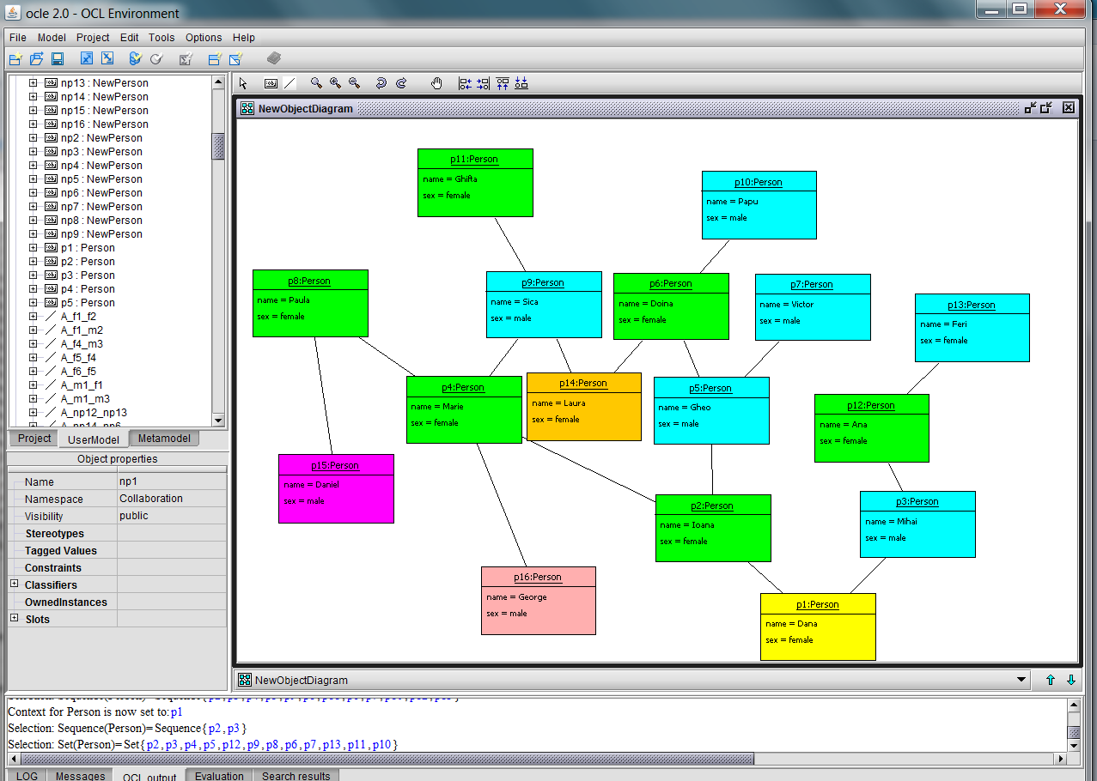
Understanding Software Modeling by Using Constraints Querying the initial model
Notes:
The result obtained by querying the initial design of the Person tree is not so suggestive like in case of the second design because the info missing are not specified clearly.

Slide 24
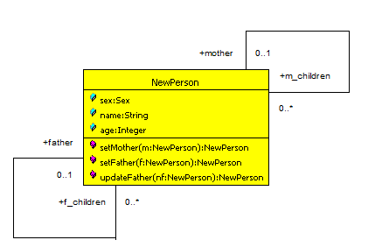
Understanding Software Modeling by Using Constraints Explaining the Intended Model Uses_2
context NewPerson
def parents:TupleType(mother:Nperson, father:NPerson) =
Tuple{mother = self.mother, father = self.father}
def allAncestors:Sequence(TupleType(mother:Nperson, father:NPerson))= Sequence{self.parents}->closure(i | i.mother.parents, i.father.parents))->asSequence-> prepend(self.parents)

Slide 25
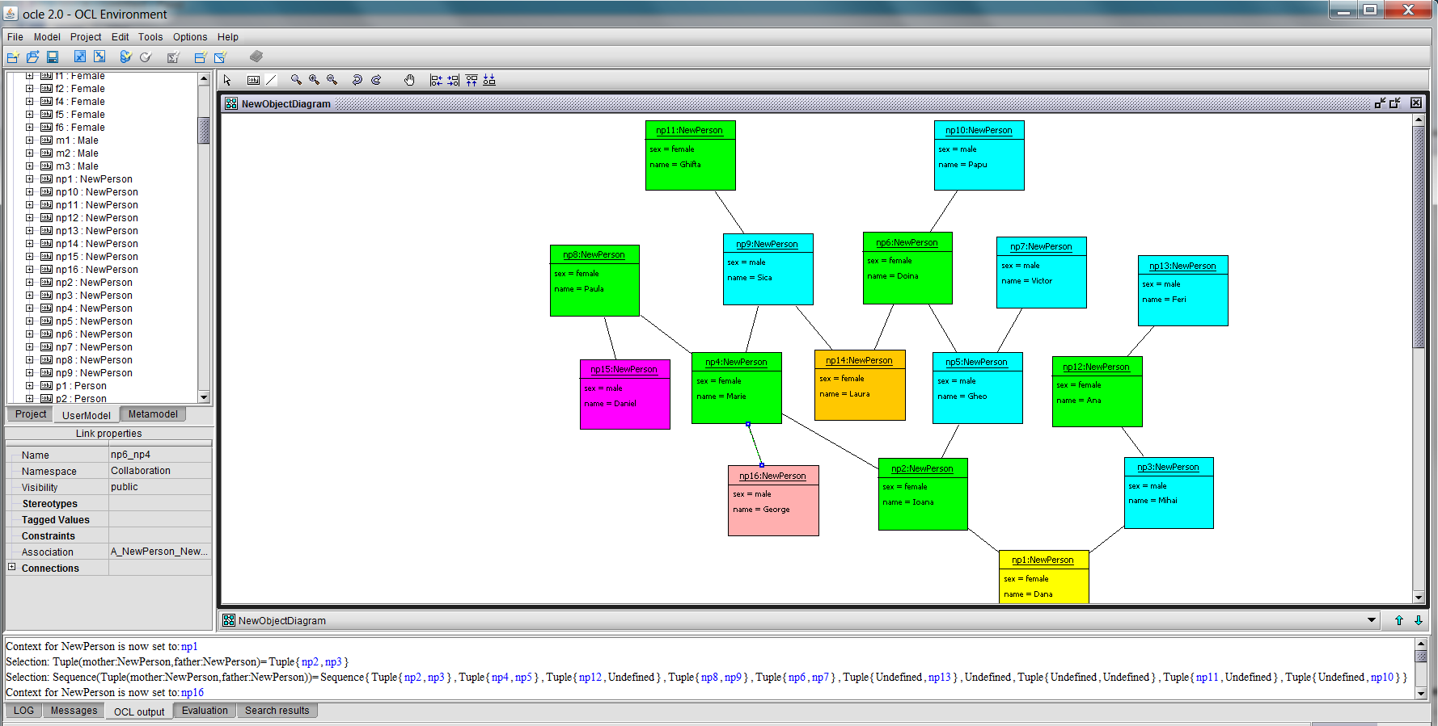
Understanding Software Modeling by Using Constraints The result obtained when querying the NewPerson tree
Notes:
The result obtained by querying the NewPerson tree is more suggestive compared with the result obtained by querying the previous Person tree

Slide 26
Understanding Software Modeling by Using Constraints Conclusion
Complementing model specification with constraints is crucial. This supports:
a rigorous model description and
detection of unwanted model instantiation
Conformance with requirements is the first criterion quality criterion in constraint specification
This requires a thorough understanding of the problem and problem domain
Abstraction is the first principle that have to be applied when modeling because identify the main concepts to use
Identifying and specifying constraints follow abstraction because restricts on relationships between concepts and on their values

Slide 27
Understanding Software Modeling by Using Constraints Conclusion_2
The main attitude in specifying constraints is the rigor
In our opinion, hastiness is the main enemy in the constraint specification process
The quality of constraint specification includes also different other criteria
Requirements must include the description of the intended usage of the system
The constraints' role is to support a better quality of the model
When judging the quality of the model, all descriptions including constraints must be considered
Choosing the most appropriate model, supposes analyzing many proposals

Slide 28
Understanding Software Modeling by Using Constraints References
[1] A UML-based Specification Environment, http://www.db.informatik.uni-bremen.de/projects/USE
[2] Software Technology Group at Technische Universit¨at Dresden: Dresden OCL, http://www.dresden-ocl.org/index.php/DresdenOCL
[3] LCI (Laboratorul de Cercetare ın Informatica): Object Constraint Language Environment (OCLE), http://lci.cs.ubbcluj.ro/ocle/
[4] Todorova, A.: Produce more accurate domain models by using OCL constraints (2011), https://www.ibm.com/developerworks/rational/library/accuratedomain-models-using-ocl-constraints-rational-software-architect/

